Slide 1
Value Proposition of the Childhood Cancer Collaborative Platform Trials (C3PT) to Industry Partners
2026
v 1.0

Slide 2
Key Issues Identified by Industry
Regulatory Complexity
US RACE for Children Act and EU Legislation require early paediatric development plans
  iPSP/PIP submissions often required before adult efficacy data are available
Differing expectations from FDA and EMA, despite increased coordination
Recruitment Feasibility
Small patient populations
Competing studies
Rare molecularly defined cancers
Study Delivery
Paediatric specific dosing, formulation and safety considerations
Ethical and consent requirements
Commercial incentives inadequate for compelling business case
Pressure to deliver rapidly

Slide 3
Our proposed solution is the utilization of
Academic-sponsored Platform Trials

Slide 4
Why Industry Should Engage with Academic Platform Trials?
PATIENT ACCESS:
Faster enrollment and quality data
OPERATIONAL EFFICIENCY:
Proven frameworks reduce setup time and costs
REGULATORY ADVANTAGE:
Supports PIP/iPSP obligations and speeds approvals
ESTABLISHED TRACK RECORD:
Successful global collaborations
PATIENT BENEFIT:
Expedited development of safe and effective treatments for children and young people with cancer

Slide 5
What is a Platform Trial?
[
]
A platform clinical trial is designed to evaluate multiple treatments at the same time within a single, ongoing trial structure, usually for the same disease or condition.
Treatments are evaluated for safety and /or efficacy in independent arms

Slide 6
Academic-led
Platform Trials
Offer:
  Structured paediatric oncology networks with
  disease and site expertise
  Established framework for rapid setup, efficient recruitment, and cost-effective delivery
  Regulatory endorsement via EMA and FDA scientific advice
  Avoidance of competition for patients between independent industry trials

Slide 7
What is our Value Proposition?
Patient Access:
Platform trials deliver quality data in a rare patient population that could lead more rapidly to patient benefit.
Operational Effectiveness:
Platform trials provide Pharma and Biotech access to subject area expertise and an efficient trial delivery mechanism, with clear budgets and timelines
Regulatory Alignment:
Platform trials are an effective mechanism whereby paediatric strategies and development plans can be met efficiently with real time access to regulatory authorities and can support paediatric regulatory obligations

Slide 8
VALUE PROPOSITION
Patient Access
Access to patients is unparalleled:
  Academic Platform Trials are delivered within well-established academic consortia comprising international networks of leading specialist paediatric oncology centres, facilitating ease of enrollment
Access to topic-specific expertise:
  Academic Platform Trials are led by KOLs who are experienced clinical investigators with topic-specific expertise and extensive hands–on experience in paediatric oncology patient care and designing trials alongside patient advocates for patient benefit

Slide 9
VALUE PROPOSITION
Operational Effectiveness
Experienced Operational Team:
  Accelerated site set-up through direct access to clinical operations and methodology experts with specialist paediatric oncology expertise, helping sites navigate complex study-specific and operational challenges
Operational Ease and Cost-Efficient Delivery
  Track record in delivering adaptive designs
  Addition of new ‘arms’ to established and open Academic Platform Trials is time and resource efficient
  Established platforms have agreed regulatory endorsed endpoints/designs
  Less time taken overall which translates to less operational costs

Slide 10
VALUE PROPOSITION
Regulatory Alignment
Academic Platform Trials can enable companies to:
  Deliver paediatric strategies and development plans
  Meet regulatory obligations for agreed PIPs and iPSPs
  Access added paediatric oncology expertise
Academic Platform Trials’ prior engagement with regulatory authorities provides:
  Endorsement of the trial specific methodology
    Assurance on the acceptability of the trial’s patient population, trial endpoints and statistical principles
  Regulatory authority familiarity with the platform trial
    Potential for more efficient regulatory negotiation timelines

Slide 11
Established Track Record:
Delivering for Industry and Patients
Measure | Across the 3 Platforms*
Years of operation | 2015-2025+
Industry assets included | 21+
Company partnerships | 12+
Regulatory programmes supported | Multiple PIPs/iPSPs, FDA and EMA submissions
*Based on Exemplar Academic-Industry Collaborative Platform Trials include: AcSe-ESMART, Glo-BNHL, Hemi-iSMART

Slide 12
Industry Engagement with
Academic Platform Trials
Transform promising therapies into patient benefit faster through patient access, trial efficiency, regulatory readiness, and proven multistakeholder collaboration

Slide 13
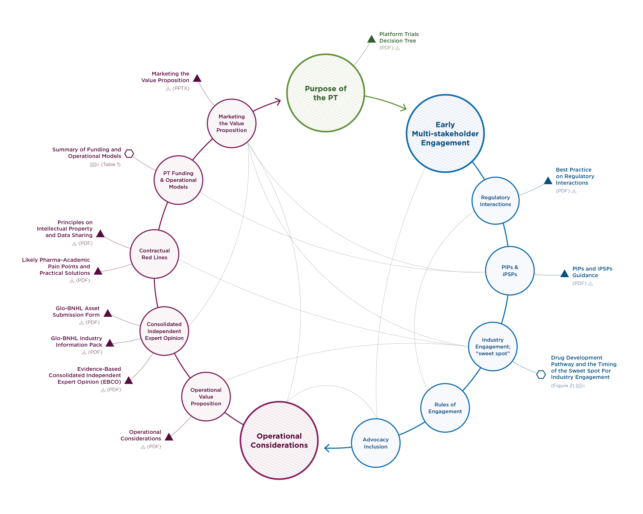
C3PT
A Multistakeholder Collaborative
The path is laid.
Use the C3PT Position Narrative and tools to move from interest to informed action.

Slide 14
For more information on C3PT:
https://MRCTcenter.org/C3PT

