Slide 1

Using Plain Language
Accessibility 101 Training Module Series
Willyanne DeCormier Plosky, Program Director, MRCT Center
10/22/24

Slide 2

Disclaimer
This material and opinions expressed here are not intended to represent the position of Brigham and Women's Hospital, Mass General Brigham, Harvard University, HHS, FDA, or any organization, institution, or entity.
The MRCT Center is supported by voluntary contributions from foundations, corporations, international organizations, academic institutions, and government entities (see https://mrctcenter.org/), as well as by grants. We are committed to autonomy in our work and to transparency in our relationships.
This work is licensed under a CC BY-NC-SA 4.0 license. Do not copy or use without permission from, and acknowledgement of, the MRCT Center.

Slide 3

About Us
The MRCT Center is an applied policy center focused on addressing the conduct, oversight, ethics and regulatory environment for clinical trials around the world.

Slide 4
Accessibility 101 Training Modules
This module is the 6th in the Accessibility 101 training series. These modules can be taken on an individual basis or used by moderators (with permission from, and acknowledgement of, the MRCT Center) for group training.
Accessibility 101 Training Module 1_Learning About Disability Inclusion
Accessibility 101 Training Module 2_Mapping the Participant Journey
Accessibility 101 Training Module 3_Creating Alt Text
Accessibility 101 Training Module 4_Assessing Color Contrast
Accessibility 101 Training Module 5_Using Plain Language
Accessibility 101 Training Module 6_Developing Accessible PowerPoints
Website: TBD

Slide 5
Plain Language: Background
Plain language is a clear and understandable way of communicating. Clear communication is critical when the information being communicated is necessary for people to make important decisions, such as in clinical research.
The intent is that your audience will be able to understand what you are communicating they first time they read or hear it.
There are many places where plain language can be used, such as:
  Recruitment emails or posters
  Informed consent forms
  Study instructions
  Patient portals or other apps
  Research publication abstracts

Slide 6
Plain Language: Summary of the 8 Steps
7 Steps for Better Accessibility Through Plain Language:
  Break up large blocks of text (by concept)
  Test the grade level for your text
  Identify complex words and substitute simpler ones
  Add definitions and weblinks (if needing to use a complex word)
  Check for use of the active voice
  Re-test the grade level for your [edited] text
  Review whether the content flows in a logical order
  Check for inclusive language

Slide 7

Plain Language How-to
Step 1a: Break up large blocks of text (by concept)
Break up long paragraphs of text into 2-3 smaller paragraphs, or into single sentences.
Please note that even if a paragraph is not long in term of text, you may wish to break it up if there are numerous different concepts within the paragraph.
When you break up a paragraph, it can be helpful to use numbered lists or bullet points.

Slide 8
Plain Language How-to
Step 1: Break up large blocks of text, example with bullet points
Here is an example of a paragraph that is not long in terms of text. However, this paragraph contains several different concepts:
“Throughout the course of this research, identifiable information (including your DNA sequencing or genomic data) about your health will be collected. De-identified genomic data generated in this study may be deposited in databases that will be publicly accessible via the Internet.”
Here is the same paragraph, which we have broken up into bullet points:
  Throughout the course of this research, identifiable information about your health will be collected.
  Identifiable information includes your DNA sequencing or genomic data.
  De-identified genomic data generated in this study may be deposited in databases.
  These databases will be publicly accessible via the Internet.

Slide 9
Plain Language How-to
Step 2: Test the grade level for your text
Run the “broken-up” text through a health literacy editor. The editor is easier to use when you have smaller blocks of text to review.
There are many versions of these editors. Here is one version (from Australia) that we have found to be user-friendly: https://www.sydneyhealthliteracylab.org.au/health-literacy-editor. Edit to make sure that the text is at about a 6th grade reading level (for a general audience). You might consider reducing the grade reading level if participants will be people with cognitive or intellectual disabilities.
On the next slide we show an example where we took the two sentences from the “broken-up” paragraph on slide 8 and put them into the health literacy editor.
You will see that the health literacy checker assesses the text to be at a grade level of 14.8, which is far above the 6th grade level that we are aiming for. The health literacy editor highlights words that are too complex.

Slide 10
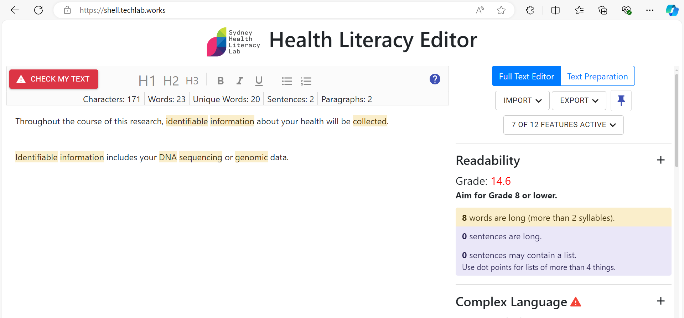
Plain Language How-to
Step 2: Test the grade level for your text, cont.

Slide 11
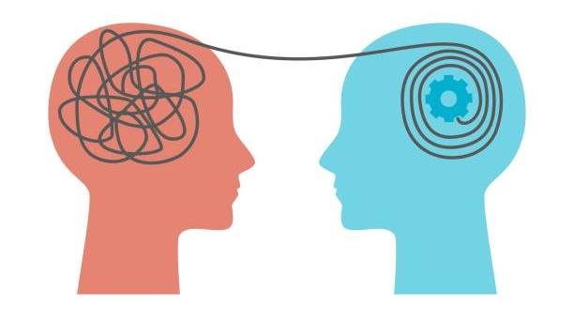
Plain Language How-to
Step 3: Identify complex words and substitute simpler ones
Identify words or phrases that may not be clear to some people reading the text. The health literacy editor can help, but by highlighting some of the difficult words (although not all).
Examples of such words often used in clinical research include identifiable or de-identified, information, collect, and genomic. Note that “data” was not highlighted by the editor, but it is a term that can be a difficult for some people.
Substitute simpler words for complex ones (e.g., “masked” or “hidden” instead of “de-identified” personal information).

Slide 12
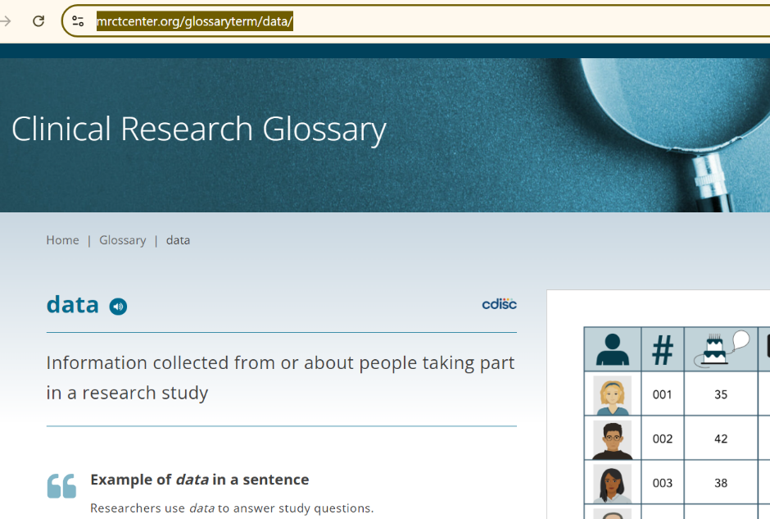
Plain Language How-to
Step 4a: Add definitions and weblinks (find the definition)
If you must use a complex word, because it is standard in clinical research, such as “data,” include a common definition for it the first time the word is mentioned.
The MRCT Center Clinical Research Glossary at https://mrctcenter.org/clinical-research-glossary/ has common definitions and visual graphics for over 100 clinical research terms.

Slide 13
Plain Language How-to
Step 4a: Add definitions and weblinks (add the definition and link)
First find the definition for the word in the Clinical research Glossary, and then add that definition into your sentence.
To add a weblink, highlight the website address with your cursor, copy it (CTL+ C on a PC, Command+C on a Mac), and paste it (CTL+V on a PC, Command+V on a Mac) into your document after the definition. Using the full link (rather than hyperlinking to the word “data”) is more accessible for screen readers.
For example, in screenshot on the previous slide, there is a sentence that reads, “Researchers use data to answer study questions.” IF that is the first time that we are using the word data in a document are creating, we could adapt the sentence to say, “Researchers use data, or information about you and other people taking part in a research study (see definition at: https://mrctcenter.org/glossaryterm/data/), to answer study questions.”

Slide 14
Plain Language How-to
Step 5: Check for use of the active voice
In sentences where authors use the passive voice, the subject comes after the verb (object + verb + subject), or the subject is missing (object + verb). This is confusing because it is contrary to how we speak in English, where we usually make the subject (or the “who”) the focus of the sentence (subject + verb + object). We advise that you change the passive voice to the active voice.
Here is the same first sentence that you saw in slide 8 with the passive voice, and an edited version using the active voice. We have noted the object, verb, and subject (where used). We highlighted the passive voice in yellow and the active voice in blue.
  Throughout the course of this research, identifiable information (object) about your health will be collected (verb). [note there is no subject- that is, who will be doing the collecting)
  Change to: Throughout the course of this research, we (subject) will collect (verb) identifiable information (object) about your health.

Slide 15
Plain Language How-to
Step 6: Re-test for the grade level (for your edited text)
Here is an example of the same two sentences from slide 8, which we edited by breaking up the sentences into bullet points, using simpler words, and changing the passive voice to the active voice. This example is now at a reading level of 6.9 in the editor (if we don’t assess the term DNA).
During the research, we will record and keep “data,” or information, about you. Data can be:
  Your name
  Your birthday
  Your height, weight, or other body measures
  Things you have told your doctor or put on forms
  Your test results (such as blood tests)
  Your ‘genetic testing’ data. These tests are medical tests that look at your genes (sometimes called DNA) to understand if you have a health risk. Your genes are like a map inside the cells of your body that says who you are.

Slide 16
Plain Language How-to
Step 7: Review whether the content flows in a logical order
Here is the same table. Note that the content is in logical order because the first sentence explains what is listed below, the first bullet points on more commonly collected (your name) information are before bullet points on less commonly collected (test result) information, and the broader point on test results is before the more specific point on genetic test [results].
During the research, we will record and keep “data,” or information, about you. Data can be:
  Your name
  Your birthday
  Your height, weight, or other body measures
  Things you have told your doctor or put on forms
  Your test results (such as blood tests)
  Your ‘genetic testing’ data. These tests are medical tests that look at your genes (sometimes called DNA) to understand if you have a health risk. Your genes are like a map inside the cells of your body that says who you are.

Slide 17
Plain Language How-to
Step 8: Check for inclusive language
Check to avoid expressions that may exclude some people with disabilities such as “lift our voices,” “put your best foot forward,” “turn a blind eye,” or “stand with us,”
Work with people with disabilities to assess if they would like to use person-first language (e.g., person with autism), identity-first language (e.g., autistic person) or alternate between the two. You may explain your choice/s at the beginning of your document or presentation if you wish. Please note,
  For people who prefer it, person-first language is about respect, dignity, agency, and seeing the person first and the disability second (e.g., person with autism).
  Other people prefer identity-first language (e.g., autistic person) as an expression of empowerment and positive social identity.

Slide 18
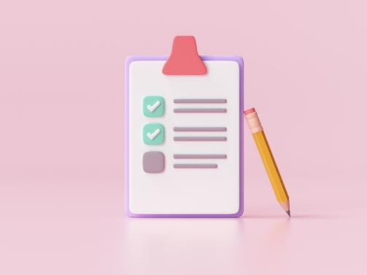
Plain Language: Exercise instructions
Please read through the text on the next slide. The text will be in four sentences.
Convert each sentence into plain language, according to the summary of the 8 Plain Language steps (see slide 6) and the how-to instructions.
If you are taking this training individually, write down notes about how you are converting the complex sentences into plain language. Be sure to reference the number of the sentence you are working on.

Slide 19
Plain Language: Exercise instructions, cont.
If you are taking the training with a group, you may raise your hand or submit thoughts to the training moderator via the Zoom chat, a WordCloud, or Zoom WhiteBoard (where available and accessible*). Be sure to reference the exercise number you are working on.
A summary of responses can be added to the blank “Lessons Learned” slides at the end of this exercise. You may then review the “Example Lessons Learned” slides, which contain examples of responses given by others that have taken took this course.
*See here for information on creating accessible WordClouds: https://www.linkedin.com/advice/1/what-most-effective-ways-create-accessible-word-pzk4f

Slide 20
Plain Language Exercise:
Convert complex sentences to plain language
This randomized clinical trial will assess the safety and efficacy of a novel biologic for inflammatory respiratory conditions.
Your collected health information (including any genomic data) is protected and considered private under federal law; we take numerous steps to walk the line on data privacy.
De-identified data generated in this study may be deposited in databases, and accessible to research teams behind a two-factor authentication firewall.
In order for effective research to be performed, your data may be shared with the following entities: The sponsor(s) of this study, other researchers and medical centers that are part of this study, Institutional Review Boards (IRBs), and organizations that provide independent accreditation and oversight of hospitals.

Slide 21
Example
Answers to the Plain Language Exercise
This is a research study that will test if a new treatment is safe and works well. The new treatment we are testing is for ‘inflammatory conditions’ like asthma, which cause the tubes in your lungs to swell up and make it hard to breathe.
The law says that we must keep your data safe and private. Data can be:
  Your name
  Your birthday
  Your height, weight, or other body measures
  Things you have told your doctors or put on forms
  Your test results (such as blood tests)
  Your “genomic” data, which is like a map inside the cells of your body that says who you are.

Slide 22
Example
Answers to the Plain Language Exercise, cont.
We do our best to ‘de-identify’ your data. To do that we hide your name and use a code number for you. This means no one who looks at the data knows that it came from you. We keep all your data that is on paper in a locked cabinet. We keep your data that is on a computer locked behind a secure password.
We only share your data with people working on the clinical trial who need it to do their jobs. Those people will have rules for keeping your data safe, but sometimes they are different than ours. Once they have your data, we can’t promise it will stay private.

Slide 23
Lessons learned about plain language
Point 1:
Point 2:
Point 3:
Point 4:
Point 5:

Slide 24
Example
Lessons learned about plain language
Documents like informed consent can have very dense legal language, which seems to be more about protecting the research entity than the participant.
This takes more time than you might guess. But once done properly, the revised language is much easier for everyone, not just people with disabilities, to understand.
Creating plain language versions is an art. If you are using a health literacy editor, you may need to try different types of changes (e.g., breaking up text, simpler words, active voice) over multiple rounds of editing to reduce the grade level. Note that such editors are helpful guides but should not be used rigidly. It is better for real people/communities to review the text.
It may be ok to have one complex word in a sentence, especially if it has been defined before in the document, but having multiple complex words in a sentence is problematic.
Consider cutting the amount of text to only include what is important to communicate.

Slide 25
Additional resources for plain language
The MTCT Center. Health Literacy in Clinical Research website: Plain language. Available from: https://mrctcenter.org/health-literacy/tools/overview/plain-language/
https://www.plainlanguage.gov/
Harvard Catalyst. Plain language materials development checklist. Available from: https://catalyst.harvard.edu/wp-content/uploads/2023/02/Plain-language-checklist-FINAL-fillable.pdf
Warmington K. Plain language strategies (webinar). Available from: https://iod.unh.edu/resource/plain-language-strategies

Slide 26

Accessibility 101 Webinars
July 9, 2024: Accessibility 101: How to Write Alt-Text and Map Participant Journeys. Available at: https://mrctcenter.org/?sfid=229&_sf_s=accessibility%20101
October 22, 2024: Implementing Health Literacy Training in HRPPS and IRBs. Available at: TBD
Please note, these webinars have been conducted in collaboration with Research Ethics Action Collaborative for HRPPs (REACH) Project. For a list of additional REACH resources, please see: https://mrctcenter.org/wp-content/uploads/2024/03/REACH-Resource-List-BB.pdf

Slide 27


Thank You!
Learn more at www.mrctcenter.org

