Slide 1

Developing Accessible Powerpoints
Accessibility 101 Training Module Series
Willyanne DeCormier Plosky, Program Director, MRCT Center
10/22/24

Slide 2

Disclaimer
This material and opinions expressed here are not intended to represent the position of Brigham and Women's Hospital, Mass General Brigham, Harvard University, HHS, FDA, or any organization, institution, or entity.
The MRCT Center is supported by voluntary contributions from foundations, corporations, international organizations, academic institutions, and government entities (see https://mrctcenter.org/), as well as by grants. We are committed to autonomy in our work and to transparency in our relationships.
This work is licensed under a CC BY-NC-SA 4.0 license. Do not copy or use without permission from, and acknowledgement of, the MRCT Center.

Slide 3

About Us
The MRCT Center is an applied policy center focused on addressing the conduct, oversight, ethics and regulatory environment for clinical trials around the world.

Slide 4
Accessibility 101 Training Modules
This module is the 6th in the Accessibility 101 training series. These modules can be taken on an individual basis or used by moderators (with permission from, and acknowledgement of, the MRCT Center) for group training.
Accessibility 101 Training Module 1_Learning About Disability Inclusion
Accessibility 101 Training Module 2_Mapping the Participant Journey
Accessibility 101 Training Module 3_Creating Alt Text
Accessibility 101 Training Module 4_Assessing Color Contrast
Accessibility 101 Training Module 5_Using Plain Language
Accessibility 101 Training Module 6_Developing Accessible PowerPoints
Website: TBD

Slide 5
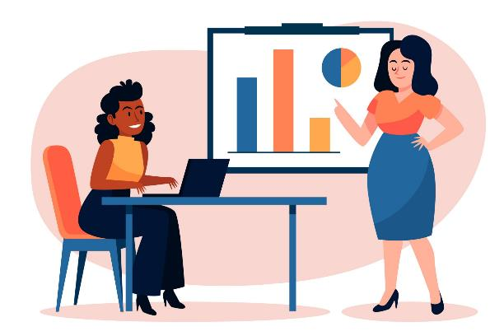
Accessible PowerPoints: background
Decisions are made at meetings and conferences that drive all aspects of clinical research.
Close to 60% of meetings are now virtual.
PowerPoint use is common at in-person meetings. It is nearly ubiquitous at virtual meetings.
People like to get a copy of the PowerPoint slides so they can review the information from the meeting.
If people can’t access or fully review PowerPoints, they may lose opportunities to plan, conduct, participate in, and/or learn from clinical research.
​​

Slide 6
Accessible PowerPoints: Summary of the 10 Steps
10 Steps for PowerPoint Accessibility:
  Define the intended purpose for the PowerPoint
  Define the intended audience for the PowerPoint
  Design for mental processing
  Design with appropriate language
  Design for readability
  Design for supportive sensory processing
  Use Alt Text
  Assess color contrast
  Check accessibility
  Plan for PowerPoint viewing and supplementary materials

Slide 7
Accessible PowerPoints How-to
Step 1: Define the intended purpose for the PowerPoint
PowerPoint has many uses, in meetings, and elsewhere. Such as:
A memory aid for people presenting to an audience.
A summary of the key points of an in-person or virtual presentation.
An on-demand training or educational tool. In some cases, this may involve embedding a video or recording in the PowerPoint.
A tool to create infographics, informational handouts, instructions, or surveys.
A slideshow, such as a photo album that is shown at the front of a room.
Give careful thought to PowerPoint purpose. Gather other PowerPoint examples that have been used for this purpose to see how they are structured.

Slide 8
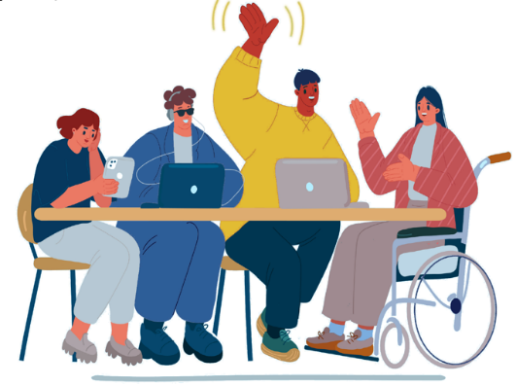

Accessible PowerPoints How-to
Step 2: Define the intended purpose for the PowerPoint
What is the expected audience size?
(Hint: Some meeting and training formats do not work well with large audiences. Plan your PowerPoint accordingly).
Will the audience include people with disabilities? (Hint: Always).
What accommodations have been requested? (Hint: Did you ask?)
Will the audience include non-English speakers? (Hint: If the text on the PowerPoint will be translated, makes languages than in English). sure to leave enough space. Text strings can be longer in other
​​

Slide 9

Accessible PowerPoints How-to
Step 3: Design for Mental Processing
Provide an agenda and/or background information early in the presentation.
Check the reading order for text or graphics on each slide. In English, we read from left to right and from the top to the bottom of the page. The presented information should flow in that order. Other languages may change that order.
Give opportunities for people accessing the presentation to take a break from being “talked-at.” Pause for questions. Reinforce concepts with examples. Build in practice exercises.
Summarize key take-aways and lessons learned.

Slide 10
Accessible PowerPoints How-to
Step 4a: Design with appropriate language (plain language)
Plain language is a clear and understandable way of communicating. Helpful hints include:
  Break up large blocks of text into smaller paragraphs or bullet points.
  Identify complex words or phrases and substitute simpler ones. If you must use a complex word, such as “participant,” include a common definition for it the first time you use the word. Or hyperlink to common definitions, such as those in the MRCT Center Clinical Research Glossary, available at: https://mrctcenter.org/glossary/ .
  Use a health literacy checker app to test the grade level for your text, such as https://www.sydneyhealthliteracylab.org.au/health-literacy-editor.
  Edit to make sure that the text is at an 8th grade reading level (for a general audience) or a 4th grade reading level (if participants will be people with cognitive or intellectual disabilities).
Please note: Full instructions on plain language are available on the MRCT Center Plain Language webpage (at: https://mrctcenter.org/health-literacy/tools/overview/plain-language/ ). Or in the MRCT Center Accessibility 101 training on Plain Language.

Slide 11
Accessible PowerPoints How-to
Step 4b: Design with appropriate language (inclusive language)
Check to avoid expressions that may exclude people with disabilities such as “lift our voices,” “put your best foot forward,” or “stand with us.”
Work with people with disabilities to assess if they would like to use person-first language (e.g., person with autism), identity-first language (e.g., autistic person) or alternate between the two. You may explain your choice/s at the beginning of your PowerPoint presentation if you wish.
Recognize that people have intersecting identities. For example, you can also review the MRCT Center LGBTQIA+ Inclusive Language Checklist, at: https://mrctcenter.org/wp-content/uploads/2024/04/Inclusive-language-checklist.pdf

Slide 12
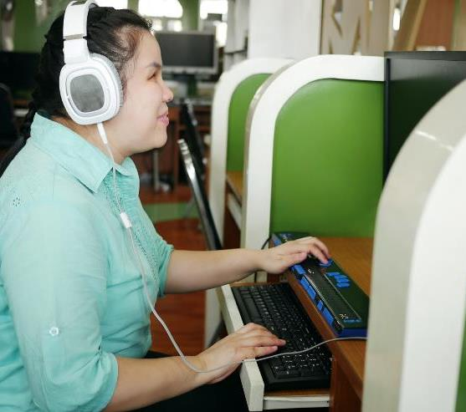
Accessible PowerPoints How-to
Step 5a: Design for readability (font, bullets, and alignment)
Use unique and descriptive slide titles.
Do not use serif fonts (e.g., Times New Roman, Garamond) or “fun” fonts that can be difficult to see (e.g., Magneto, Curlz MT). Instead, use a sans serif font (e.g., Calibri, Avenir, Arial), and aim for 20-point size or larger.
Use the standard bullets option in PowerPoint. Add full stops at the end of each bullet point so that screen readers can recognize them.
Use left aligned text, not justified or centered.
Limit use of bold font, italics, ALLCAPS, asterisks,
or dashes.

Slide 13
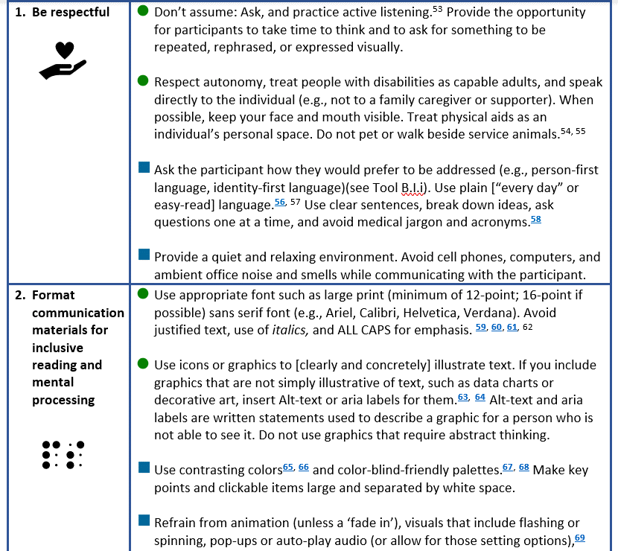
Accessible PowerPoints How-to:
Step 5b: Design for readability (avoid screenshots)
Avoid using screenshots (like the one at right). The words in them can’t be read by screen readers, because the screenshot is a picture. Also, screenshots can have small font and appear blurry.
If you must use a screenshot, clearly describe in the Alt Text (see slide 14) for the screenshot the information being conveyed.

Slide 14


Accessible PowerPoints How-to:
Step 5b: Design for readability (avoid screenshots, cont.)
A better option is to recreate the information from the screenshot into a text box or table that can be read by screen readers.
To format tables for screen readers, make sure you can get to each cell (starting at the top left) using your tab key. Also, add a header row.
Grouping | Key Points
1. Be respectful | Don’t assume: Ask, and practice active listening. Provide the opportunity for participants to take time to think and to ask for something to be repeated, rephrased, or expressed visually. People with disabilities are capable adults. Respect autonomy and speak directly to the individual. When possible, keep your face and mouth visible. Treat physical aids as an individual’s personal space. Do not pet or walk beside service animals.
2. Format communication materials for inclusive reading and mental processing | Use appropriate font such as large print (minimum of 12-point; 16-point, if possible, in documents) sans serif font (e.g., Ariel, Calibri, Verdana). Avoid justified text, use of italics, and ALL CAPS. Use contrasting colors and available tools to check that the degree of contrast is sufficient. Make key points and clickable items large and separated by white space. Refrain from animation, visuals that include flashing or spinning, pop-ups or auto-play audio (or allow for those setting options).

Slide 15
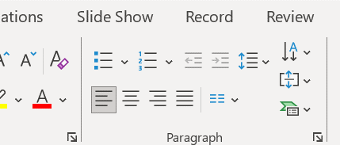
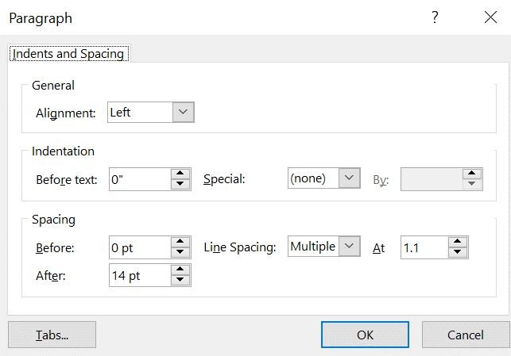


Accessible PowerPoints How-to
Step 5c: Design for readability (appropriate line spacing)
We recommend using a line spacing of “Multiple” at a minimum of 1.1.
To set the line spacing there are two methods:
  Highlight the paragraph/s with your cursor and right click. Then click on “Paragraph.”
  On a PC or Mac, go to the top banner, in the section for “Paragraph.” Click on the icon with two blue up/down arrows next to four lines and a small down arrow. Note that on a Mac it will say “Line Breaks and Spacing” next to “Indents and Spacing” in the “Paragraph box.

Slide 16
Accessible PowerPoints How-to
Step 6: Design supportive sensory processing
Avoid using busy patterns. Especially avoid placing important information like titles, dates, or quantities on/within a busy pattern. Likewise, avoid using CATPCHA or RECAPTCHA tests as security measures to access PowerPoint files. For alternatives to CATPCHA or RECAPTCHA tests, see here: https://www.w3.org/WAI/GL/wiki/Captcha_Alternatives_and_thoughts
Avoid using the animation feature in PowerPoint, objects that spin or fly across the screen, or pop-ups. If you do use animation, use only one animation per slide, and use options like “fade in” or “appear” that don’t involve the object moving or flashing.
Disable auto-play audio or video.
Make sure all elements are clearly visible on the screen. For example, if the user must mouse over an invisible element on the screen to show the “next slide” arrow, that is not accessible.
Do not use countdowns, ticking clocks, or timeouts.

Slide 17
Accessible PowerPoints How-to
Step 7: Use Alt Text (background)
Alt Text (or Alternative Text) are written statements that describe an image or graphic for a person who is not able to see it.
Alt Text can be read by screen readers. Screen readers are assistive technologies (software or hardware) that read information about images, menus, dialogue boxes, and files and then conveys that information through an audio or Braille format to the person using the screen reader.
Alt Text can be used for icons, pictures, graphics, illustrations, logos, and sometimes for charts (depending upon the complexity of the chart) and in Word documents, PowerPoint, social media, websites, apps, and some other participant-facing media. Alt Text can be displayed by websites if images do not load properly and are therefore useful for everyone.

Slide 18


Accessible PowerPoints How-to
Step 7: Use Alt Text (background, cont.)
Important: Alt Text should convey the meaning of an image as it relates to the content/context.
For decorative objects (e.g., a border or a colored line that underlines text) write “null” in the Alt Text box or select “Mark as decorative” when you get to the Alt Text screen.
Do not insert emojis or personal opinions (e.g., a disheveled patient, a beautiful patient) in Alt Text.
You should be able to clearly describe an image through brief Alt Text. Avoid using images that require abstract thinking. If you must write more than 2-3 sentences, the image is too complex.
X
A picture of a scale.
An icon of a scale, representing justice, that is equally balanced.

Slide 19
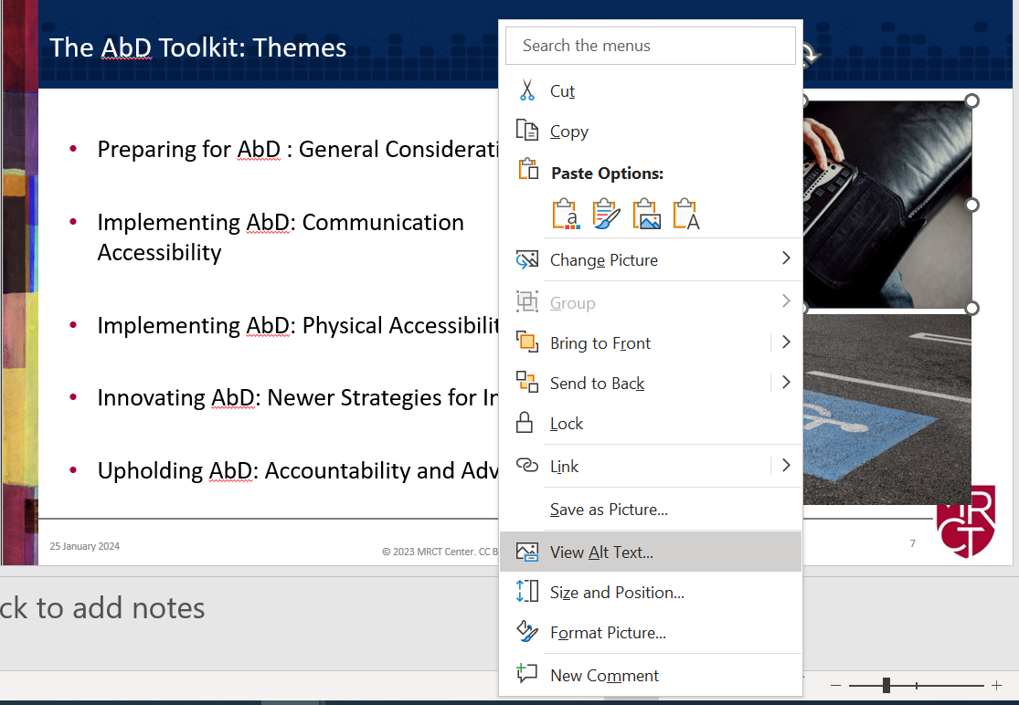
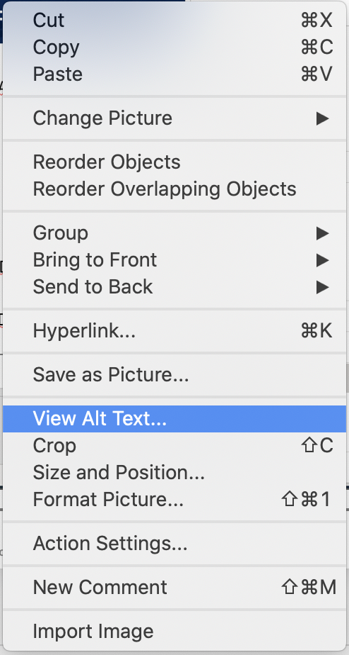
Accessible PowerPoints How-to
Step 7: Use Alt Text (instructions- PC or Mac)
Right-click on any photo, chart, or image.
Select View Alt Text from the drop-down list on a PC (shown below “PC”) or Mac (shown below the apple symbol).
Write Alt Text into the Alt Text box that pops up.
Please note: Full Alt Text instructions and exercises can be found in the MRCT Center Accessibility 101 Training Module 3_Creating Alt Text.

Slide 20
Accessible PowerPoints How-to
Step 8: Access Color Contrast (background)
Color contrast should be assessed for a high level of contrast between:
  Text/foreground color and the fill/background color
  Objects such as a text box fill color and a border
  Visual elements on charts and maps
The key is to avoid light text on a light background or dark text on a dark background.
Please note that color should not be the only means of conveying information. Descriptive text is a helpful complement.
Welcome to the MRCT Center
Welcome to the MRCT Center
X
Welcome to the MRCT Center
X
Welcome to the MRCT Center
Welcome to the MRCT Center

Slide 21
Accessible PowerPoints How-to
Step 8: Access Color Contrast (background)
While there are no standards for color contrast, one of the most common reference points is the Web Content Accessibility Guidelines (WCAG): https://www.w3.org/TR/WCAG22/. These give a ratio between the text/foreground and fill/background colors of 4.5: 1.
In the following slides, we give instructions using built-in tools in PowerPoint (or Word) and the WCAG color contrast checker, available at: https://accessibleweb.com/color-contrast-checker/
Please note that these are numerous other methods to check color contrast. One is a free program for downloaded onto your computer, called the TPGi Color Contrast Analyzer: https://www.tpgi.com/color-contrast-checker/. However, some users encounter a firewall and need (administrator) permission to download it.
Finally, note that we give fuller instructions on color contrast in the MRCT Center Accessibility 101 Training Module 4 on Assessing Color Contrast.

Slide 22
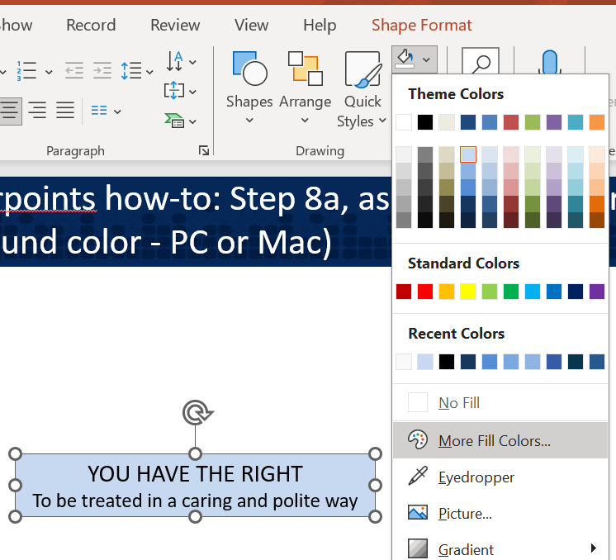
Accessible PowerPoints How-to
Step 8a: Find the fill/background color (on a PC)
On a PC right click on the box or figure (i.e., background color) in your document for which you want to check the color contrast.
You will see the box or figure is outlined with connecting circles (e.g., the blue box that says “You have the right”).
Select the paint bucket icon on the banner. Then select “More [Fill] Colors” to see what the background color in the selected box or figure is.

Slide 23
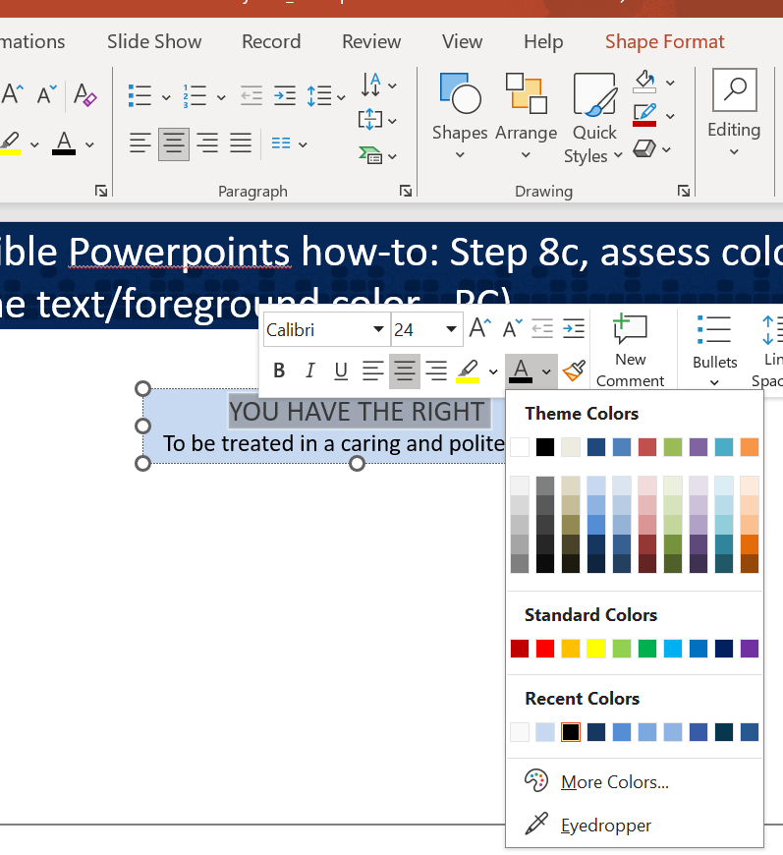
Accessible PowerPoints How-to
Step 8b: Find the text/foreground color (on a PC)
On a PC to check the text (or foreground) color, use your cursor to highlight the text font. For example, we used the cursor to highlight the text that says, “You have the right.” Then click the A with the color stripe under it.
Alternatively, click on the text box, then on the “A” with the color stripe under it on the top bar.
Then select “More [Fill] Colors” to find out what the text/foreground color is.
Finally, go to “Custom” to find the HEX code. The HEX code for black text is always #000000. For white it is always #FFFFFF.
…

Slide 24
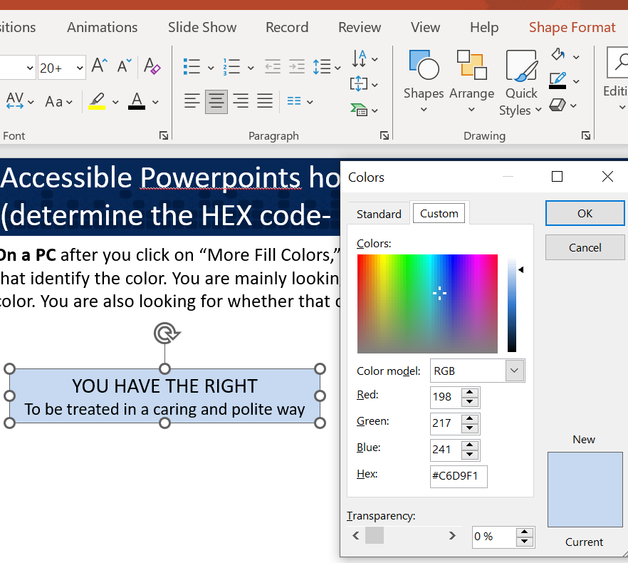
Accessible PowerPoints How-to
Step 8c: Determine the HEX code (on a PC)
On a PC after you click on “More Fill Colors,” select the “Custom” tab to see the computer codes that identify the color.
You are mainly looking for the HEX code, which is a summary code for that color. Here the HEX code for the light blue used as the fill/background color in the text box is #C6D9F1.

Slide 25
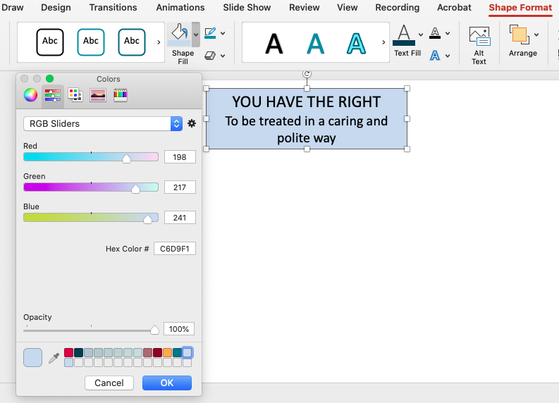
Accessible PowerPoints How-to
Step 8a-c: Access Color Contrast (determine the HEX code - Mac)
Steps 8a-8c are a little different on a Mac.
To get the fill/background color Hex code, click the paint bucket icon with the color stripe under it and “More Colors.” Then choose “RGB sliders” from the drop-down list next to the settings (gear) icon. For the text/foreground color HEX code, this is the same process except that you start by clicking on the “A” with the color stripe on the top bar.

Slide 26
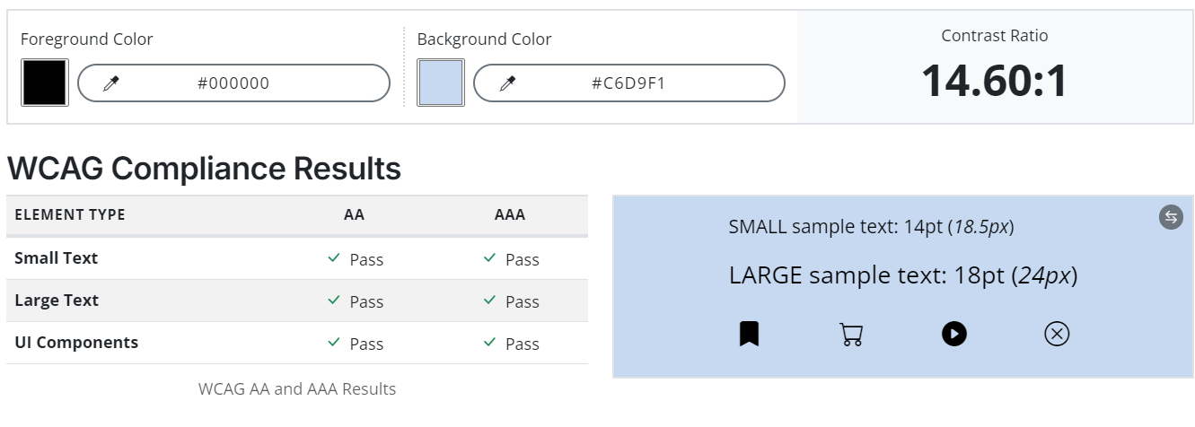
Accessible PowerPoints How-to
Step 8d: Access Color Contrast (put HEX codes into a contrast checker)
Go to WCAG Color Contrast checker: https://accessibleweb.com/color-contrast-checker/. Enter the HEX code that you found for the fill/background under “Background Color.” Then enter the text/foreground HEX code under “Foreground color”.
Finally, check the WCAG compliance results for large and small font. Here the color contrast ratio is 14.6: 1. It passes the test for both small and large text.

Slide 27
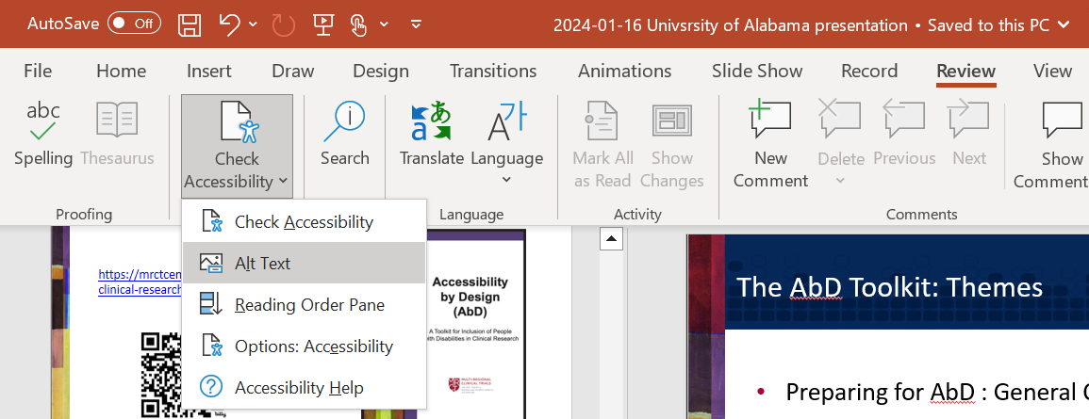
Accessible PowerPoints How-to
Step 9: Check Accessibility
Use the Check Accessibility feature to help you spot and fix accessibility errors while you work.
Go to “Review” on the top ribbon, and then to “Check Accessibility.”
You can ask the program to check all features of accessibility (circled below), or individual features of accessibility, such as Alt Text.

Slide 28
Accessible PowerPoints How-to
Step 10: Plan for PowerPoint viewing and supplementary materials
You’ve formatted your PowerPoint for accessibility. Congratulations! However, your job is not done. Please consider the following as your PowerPoint goes out in the world:
  Formatting registration forms and portals for accessibility; Asking about accommodations.
  Enabling closed captions in Zoom/virtual meetings; [In your PowerPoint formatting] Making sure the “Always Use Subtitles” box is checked on the Captions & Subtitles section under “Slide Show.”
  Recording the session, if the PowerPoint is presented in-person/virtually; Posting the video/audio recording and sharing a link with meeting attendees.
  Posting a transcript (that has been reviewed and edited) of the recorded session.
  Posting a bibliography of resources mentioned in the PowerPoint, inclusive of what was posted in the chat feature (if using Zoom), with weblinks for each resource.
  Formatting all post-webinar or training follow-up communications for accessibility.

Slide 29
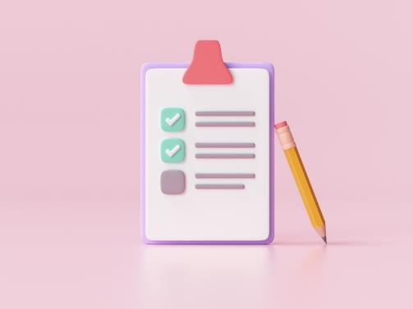
Accessible PowerPoints: Exercise instructions
Please review the following two slides. Each will show a hypothetical slide that has three or more areas where the slide could be improved for accessibility.
If you are taking the training on your own, you may write down the problems that you see. If you are taking the training with a group, you may raise your hand or submit thoughts to the training moderator via the Zoom chat, a WordCloud, or Zoom WhiteBoard (where available and accessible*). Be sure to reference the exercise number you are working on.
*See here for information on creating accessible WordClouds: https://www.linkedin.com/advice/1/what-most-effective-ways-create-accessible-word-pzk4f

Slide 30
Accessible PowerPoints: Exercise instructions cont.
A summary of responses can be added to the blank “Lessons Learned” slides at the end of this exercise. You may then review the “Example Lessons Learned” slides, which contain examples of responses given by others who have taken this course.
Please note that you may refer to the how-to slides in this training, or to the how-to sections in the complementary Accessibility 101 trainings, if you would like to correct the errors in the two exercise slides.

Slide 31
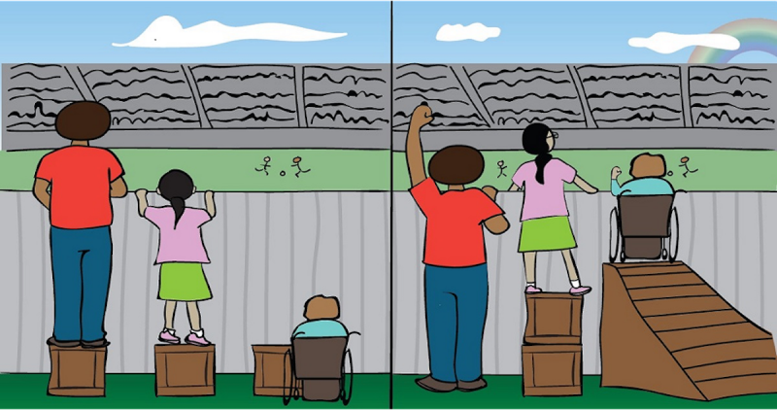
Accessible PowerPoints Exercise 1:
*EQUITY* is everyone getting the support that they need.
^EQUALITY^ is everyone getting the same support.

Slide 32
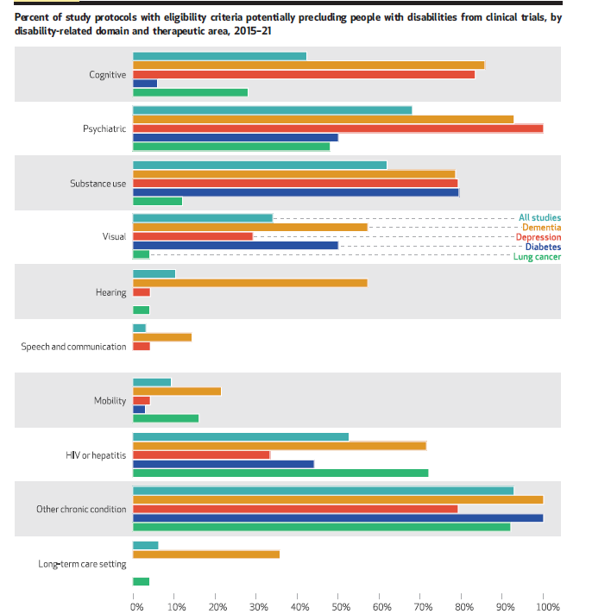
Accessible PowerPoints Exercise 2:
Exhibit 3
This chart shows the frequency of
exclusions in each disability domain by therapeutic
area. The highest frequencies of exclusions
were coded as other chronic (93 percent),
psychiatric (68 percent), substance use (62 percent),
HIV or hepatitis (53 percent), and cognitive
or intellectual (42 percent) domains; the
lowest frequencies of exclusion were coded as
visual (34 percent), hearing (10 percent), mobility
(9 percent), long-term care (6 percent), and
speech and communication (3 percent) domains.
Because the disability domain “other
chronic” served as a catchall for exclusions that
did not fit neatly into any other domain, it is unsurprising that we found high rates of exclusion
within it across all therapeutic areas.
DeCormier Plosky et al., Article at: https://www.healthaffairs.org/doi/full/10.1377/hlthaff.2022.00520

Slide 33
Example
Answers to the Accessible PowerPoint Exercise 1
The title is missing. Although there is a “title” below the blue banner at the top, it is not in the correct place or formatted as a header that could be read by a screen reader.
The font used for the quote on equality is not a sans serif font
ALL CAPS, italics, bolding, and asterisks/other symbols have been used for emphasis.
The text is formatted to be centered and not left justified.
It is not clear what part of the image each text box refs to. Is equality on the left or on the right?
The image does not have Alt Text.

Slide 34
Example
Answers to the Accessible PowerPoint Exercise 2
The box with “Exhibit 3” does not have sufficient color contrast.
The image of the figure is a screenshot.
The text box describing the table is too wordy. The text should be simplified, using plain language, and broken up using bullet points.
The line spacing in the text box is not sufficient. There should be a minimum spacing of 1.15 pt.
The “Exhibit 3” box and the table image have animation. To remove the animation, click on the small number that shows up next to the object (usually at the top left corner of the object) that is animated and hit the delete button.

Slide 35
Lessons learned about Accessible PowerPoints
Point 1:
Point 2:
Point 3:
Point 4:
Point 5:

Slide 36
Example
Lessons learned about Accessible PowerPoints
Learning how to create accessible PowerPoints is important for employees at all levels, inclusive of leadership. We all give presentations.
Creating accessible PowerPoints takes time, in part because it can be more challenging to make slides succinct and in plain language, as opposed to pasting in long sentences or paragraphs of information. Plan for time to review for accessibility.
It is easy to forget to add a slide title, or to accidentally delete it. To check that all slides have titles that are readable by screen readers, click “View” on the top menu and then “Outline View”. Look on the left panel to see all slide titles.
Accessibility for PowerPoints includes more than the design of the PowerPoint. It also includes the design of registration forms to view the PowerPoint (if for a webinar) and asking about any accommodations needed during the presentation.

Slide 37
Additional Resources for Accessible Powerpoints
Perkins School for the Blind. How to Create Accessible Powerpoints. Available at: https://www.perkins.org/resource/how-create-accessible-powerpoints/
Microsoft. Make You PowerPoint Presentations Accessible to People With Disabilities. Available from: https://support.microsoft.com/en-us/office/make-your-powerpoint-presentations-accessible-to-people-with-disabilities-6f7772b2-2f33-4bd2-8ca7-dae3b2b3ef25
U.S. General Services Administration Section 508.gov. Create Accessible Powerpoint Presentations. Available from: https://www.section508.gov/create/presentations/
Harvard University. Create Accessible Powerpoint Presentations. Available at: https://accessibility.huit.harvard.edu/microsoft-powerpoint

Slide 38

Accessibility 101 Webinars
July 9, 2024: Accessibility 101: How to Write Alt-Text and Map Participant Journeys. Available at: https://mrctcenter.org/?sfid=229&_sf_s=accessibility%20101
October 22, 2024: Implementing Health Literacy Training in HRPPS and IRBs. Available at: TBD
Please note, these webinars have been conducted in collaboration with Research Ethics Action Collaborative for HRPPs (REACH) Project. For a list of additional REACH resources, please see: https://mrctcenter.org/wp-content/uploads/2024/03/REACH-Resource-List-BB.pdf

Slide 39


Thank You!
Learn more at www.mrctcenter.org

