Slide 1
Learning About Disability Inclusion
Accessibility 101 Training Module Series
Willyanne DeCormier Plosky, Program Director, MRCT Center
10/22/24

Slide 2
Disclaimer
This material and opinions expressed here are not intended to represent the position of Brigham and Women's Hospital, Mass General Brigham, Harvard University, HHS, FDA, or any organization, institution, or entity.
The MRCT Center is supported by voluntary contributions from foundations, corporations, international organizations, academic institutions, and government entities (see https://mrctcenter.org/), as well as by grants. We are committed to autonomy in our work and to transparency in our relationships.
This work is licensed under a CC BY-NC-SA 4.0 license. Do not copy or use without permission from, and acknowledgement of, the MRCT Center.

Slide 3
About Us
The MRCT Center is an applied policy center focused on addressing the conduct, oversight, ethics and regulatory environment for clinical trials around the world.

Slide 4
Accessibility 101 Training Modules
This module is the 1st in the Accessibility 101 training series. These modules can be taken on an individual basis or used by moderators (with permission from, and acknowledgement of, the MRCT Center) for group training.
Accessibility 101 Training Module 1_Learning About Disability Inclusion
Accessibility 101 Training Module 2_Mapping the Participant Journey
Accessibility 101 Training Module 3_Creating Alt Text
Accessibility 101 Training Module 4_Assessing Color Contrast
Accessibility 101 Training Module 5_Using Plain Language
Accessibility 101 Training Module 6_Developing Accessible PowerPoints
Website: TBD

Slide 5
Disability Data
1 billion people and 240 million children globally have a disability.
People with disabilities are the largest minority group in the US (1 in 4 adults; 1 in 3 Black and Hispanic adults).
There are different kinds of disabilities such a visual, hearing, mobility, chronic conditions (like asthma), mental health, and cognitive, intellectual, or developmental disabilities. Mental health and cognitive/developmental disabilities are not the same.

Slide 6
Ableism: Definition
Ableism is defined as:
“A network of beliefs, processes and practices that produces a particular kind of self and body (the corporeal standard) that is projected as the perfect, species-typical and therefore essential and fully human. Disability then, is cast as a diminished state of being human.”
Fiona Kumari Campbell; https://research-repository.griffith.edu.au/server/api/core/bitstreams/bdf45182-e5b6-59f6-8285-2c44ad749a65/content
“Ableism is a set of beliefs or practices that devalue and discriminate against people with physical, intellectual, or psychiatric disabilities and often rests on the assumption that disabled people need to be ‘fixed’ in one form or the other.”
Leah Smith; Center for Disability Rights, https://cdrnys.org/blog/uncategorized/ableism/

Slide 7
Ableism by clinical providers
Data from the Health Affairs Special Issue on Disability and Health:
82.4% of 714 surveyed physicians assumed that people with significant disability have worse quality of life than nondisabled people (Iezzoni et al.; https://www.healthaffairs.org/doi/full/10.1377/hlthaff.2020.01452 ).
‘I am not the doctor for you’ (Legu et al.; https://www.healthaffairs.org/doi/10.1377/hlthaff.2022.00475 ).

Slide 8
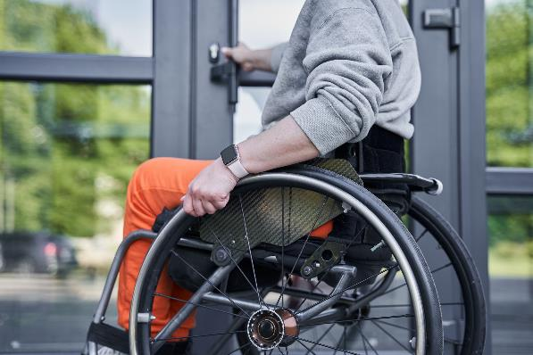
Ableism in becoming a clinical provider
3.1% of surveyed physicians self-identified as having a disability (178 of 6000). Only 9% of those (16 of 6000) identified as members of underrepresented racial groups
(Nouri et al., https://www.ncbi.nlm.nih.gov/pmc/articles/PMC7955270/).
Docs with Disabilities Initiative (led by Lisa Meeks) has helpful and practical data and tools: https://www.docswithdisabilities.org/ .

Slide 9
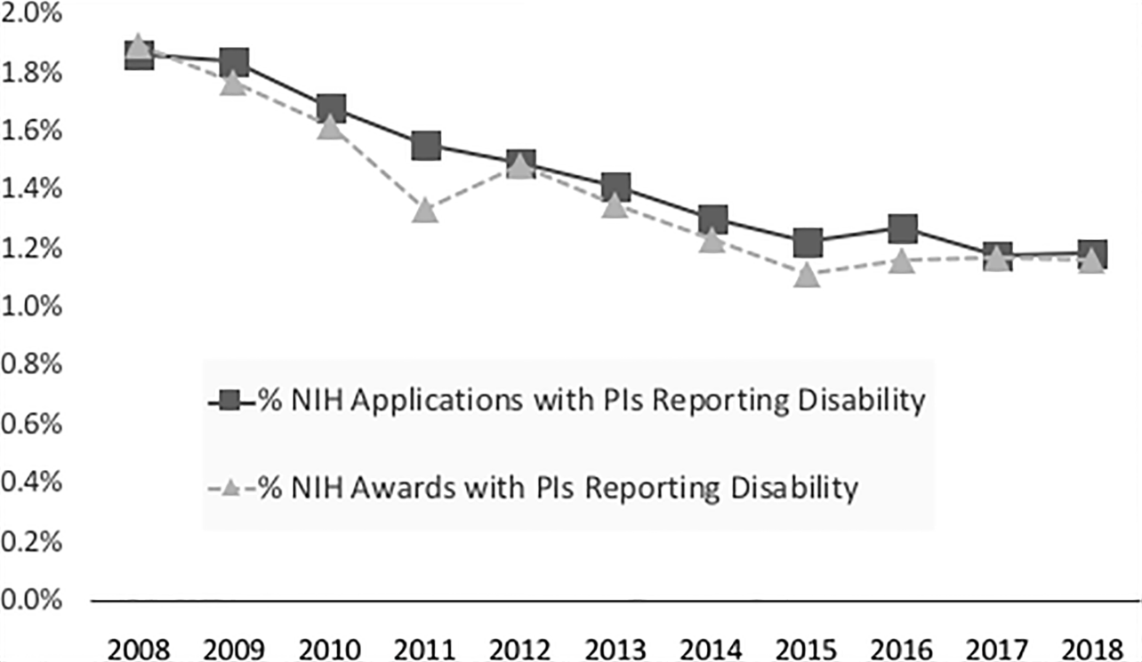
Ableism in becoming a clinical provider
NIH grant applicants with PIs reporting a disability declined from 1.9% in 2008, to 1.2% in 2018
(Swenor, Munoz, and Meeks; https://journals.plos.org/plosone/article?id=10.1371/journal.pone.0228686).

Slide 10
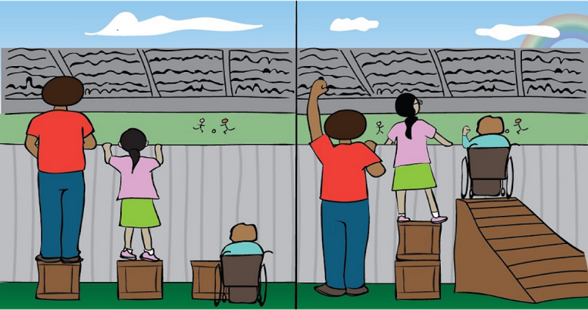
Moving from equality to equity
Equality Equality is everyone getting the same support.
Equity Equity is everyone getting the support that they need.
Image credit: Article by Beverly Ward, March 3, 2021. https://quakerearthcare.org/equality-equity-justice-the-transportation-case-example/

Slide 11
Accessibility and non-discrimination are legally mandated
International: Convention on the Rights of Persons With Disabilities (CRPD). Signed by more countries around the world, but not the United States
Federal:
Americans with Disabilities Act (ADA).
Section 504 of the Rehabilitation Act. See: https://www.hhs.gov/about/news/2024/05/01/hhs-finalizes-rule-strengthening-protections-against-disability-discrimination.html .
Section 1557 of the Affordable Care Act (ACA) prohibits discrimination against people with disabilities and requires equal access to healthcare. See: https://www.hhs.gov/civil-rights/for-individuals/section-1557/index.html .
State laws vary.

Slide 12
Accessibility and non-discrimination in clinical research is supported by medical ethics guidance
HHS: Protection of Human Subjects, 45 C.F.R. § 46.
FDA: Diversity Action Plans (DAPs) are now required for Phase 3 and later trials. Note that disability is more prevalent in minority populations (1 in 4 adults; 1 in 3 Black and Hispanic adults). Researchers are unlikely to meet the enrollment goals for minority populations if they don’t consider intersectionality and accessibility.
NIH: People with disabilities recently declared to be a population with health disparities.
HHS: The Secretary’s Advisory Committee on Human Research Protections (SACHRP)ee Recommendations Regarding Research Involving Individuals with Impaired Decision-making at: https://www.hhs.gov/ohrp/sachrp-committee/recommendations/2009-july-15-letter-attachment/index.html

Slide 13
Accessibility and non-discrimination is good for business
Disability-inclusive companies are documented to have achieved 28% higher revenue, double the net income, and 30% higher economic profit margins.
Disability-inclusive companies have more innovative products and services produced by and for people with disabilities (e.g., cruise control, texting, the internet, iPhones). Working on accommodations for people with disabilities not only accelerates innovation but can also benefit all people regardless of whether they have a disability.
People with disabilities have been shown to have higher employment retention rates and efficiency (e.g., in one company assistive devices and keyboard shortcuts allowed visually impaired telemarketers to make 100% more dials than their non-disabled peers).

Slide 14
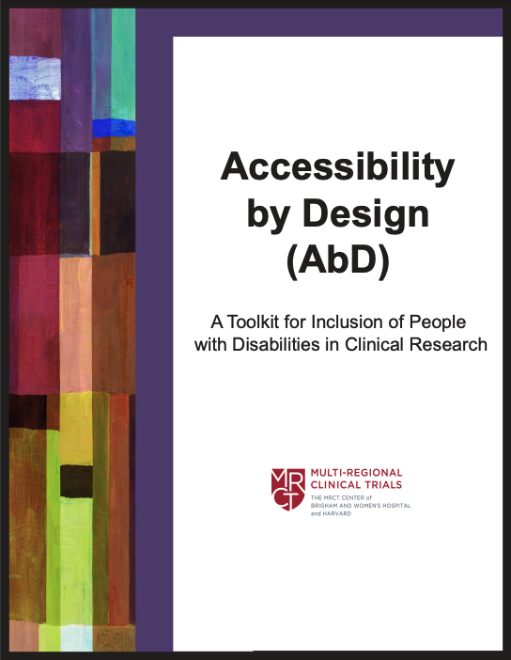
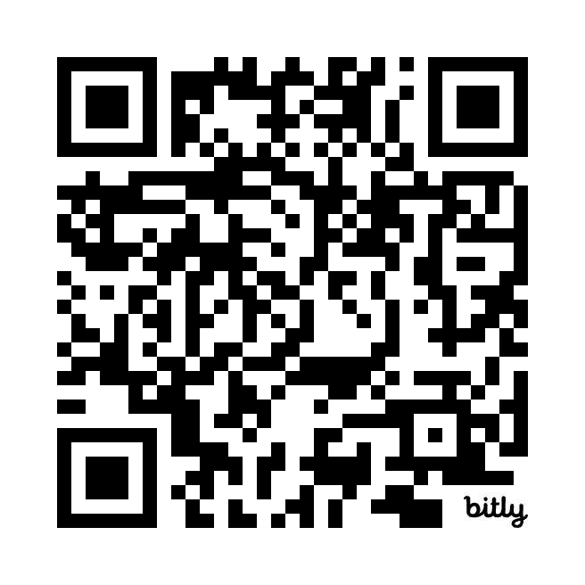
The MRCT Center Accessibility by Design (AbD) Toolkit
https://mrctcenter.org/diversity-in-clinical-research/tools/abd_toolkit/

Slide 15
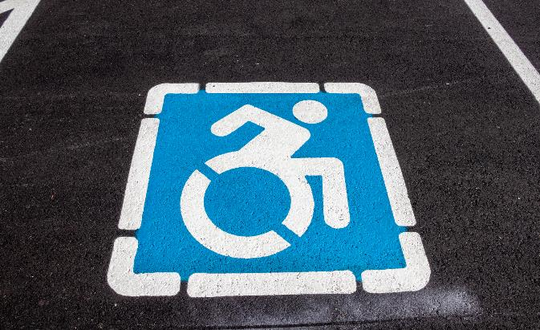
The AbD Toolkit: Themes
Preparing for AbD : General Considerations
Implementing AbD: Communication Accessibility
Implementing AbD: Physical Accessibility
Innovating AbD: Newer Strategies for Inclusion
Upholding AbD: Accountability and Advocacy

Slide 16
The AbD Toolkit: Key Points
Key points coded by skill level & feasibility:
Green circle ( ) “easy”
Blue square ( ) “moderate”
Black diamond ( ) “advanced”
Links to complementary trainings, tools, and resources.
Grouping | Key Points
1. Be respectful | Don’t assume: Ask, and practice active listening. Provide the opportunity for participants to take time to think and to ask for something to be repeated, rephrased, or expressed visually. People with disabilities are capable adults. Respect autonomy and speak directly to the individual. When possible, keep your face and mouth visible. Treat physical aids as an individual’s personal space. Do not pet or walk beside service animals.
2. Format communication materials for inclusive reading and mental processing | Use appropriate font such as large print (minimum of 12-point; 16-point, if possible, in documents) sans serif font (e.g., Ariel, Calibri, Verdana). Avoid justified text, use of italics, and ALL CAPS. Use contrasting colors and available tools to check that the degree of contrast is sufficient. Make key points and clickable items large and separated by white space. Refrain from animation, visuals that include flashing or spinning, pop-ups or auto-play audio (or allow for those setting options).

Slide 17
Example tool in the AbD Toolkit: Eligibility Criteria
Revise eligibility criteria in study protocols. Provide justification for exclusions.
Expect to provide reasonable accommodations, and clearly state they will be available.
Problematic | Preferred
Subject is judged by (or is in the opinion of) the Investigator inappropriate for the study. | Participant is documented by the Investigator to be inappropriate for the study due to the following specific scientific, safety, or ethical reasons: [Specify] (e.g., participant has a cochlear implant and cannot complete the required MRI for safety reasons).
Subject has any condition that confounds the ability to interpret data from the study. | Participant has a physical or mental condition, as determined by the study team, that is expected to significantly impact study data interpretation: [Specify] Determination of significant impact is due to the following specific scientific reasons: (e.g., participant is on an immune-suppressive and can’t receive live vaccine; has a condition documented to be associated with atypical enzyme function).

Slide 18
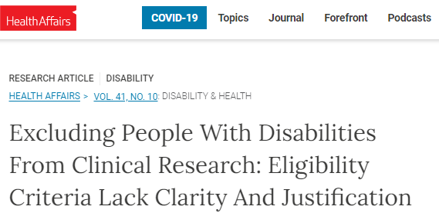
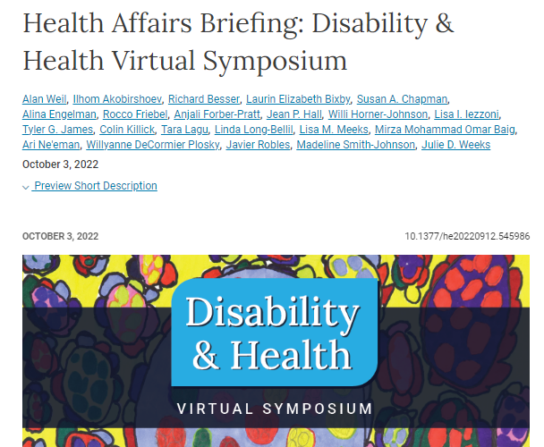
AbD tools respond to identified issues in clinical research practice
85% allowed for investigator discretion to exclude people.
Only 24% of the exclusions had a listed justification. The listed justifications were often very broad. For example, “In the investigator’s opinion, [participants] are well-motivated, and capable.”
People with cognitive and intellectual disabilities were excluded in 42% of overall studies in 4 therapeutic areas (dementia, depression, diabetes, lung cancer) reviewed, and in approximately 90% of dementia studies.
Image credit: Article by Beverly Ward, March 3, 2021. https://www.healthaffairs.org/doi/full/10.1377/hlthaff.2022.00520

Slide 19
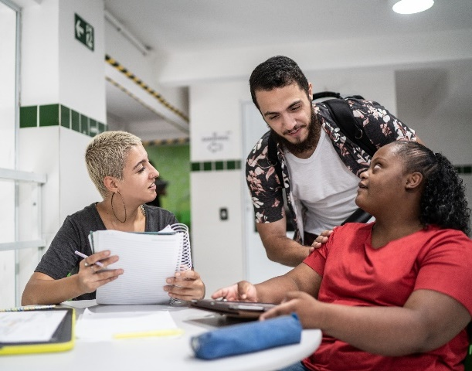
Current areas of discussion: Capacity assessment
The AbD Toolkit does not include information on how to perform a capacity assessment or the assessment measures.
Tools like the INCLUDE Impaired Capacity to Consent Framework can be helpful https://www.capacityconsentresearch.com/include-impaired-capacity-to-consent-framework.html
When to assess capacity? With whom? What about long-term decentralized trials like All of Us?
Participation as researchers:
RE4ALL: Accessible Research Ethics Education for Community Research Partners. Available from: https://re4all.org/
Image credit: Licensed under CC BY-NC-SA 4.0

Slide 20
Current areas of discussion: Decentralized trials
There is a greater push for decentralized, accessible, and rapid trials.
Will decentralized trials support or exclude people with disabilities?
Communication accessibility?
Physical accessibility?
Financial accessibility?

Slide 21
Current areas of discussion: Data
All study participants should be able to see themselves in the research data. However, demographic variables of disability have rarely been reported for clinical trials, partly because there isn’t yet domestic and international agreement on disability definitions and measurement.
Health Affairs Special Issue on Disability and Health: https://www.healthaffairs.org/disability-and-health
Census Bureau/American Community Survey; Washington City Question Set; [US] National Survey on Health and Disability
“Counting disability in the National Health Interview Survey and its consequence: Comparing the American Community Survey to the Washington Group disability measures” (Landes S, Swenor B, and Vaitiakhovich, 2024): https://pubmed.ncbi.nlm.nih.gov/37981492/

Slide 22
Current areas of discussion: Financial Neutrality
Financial neutrality for participants with disabilities.
Tax law; Impact of compensation on benefits like housing or food assistance. See the Equitable Access to Clinical Trials Project “Tax and Legal Considerations for Compensation Programs for Clinical Trial Participants” at: https://www.eactproject.org/
Travel costs may be higher for participants with disabilities that need to go to sites with accessible medical equipment (see the MRCT Center Response to DOJ Public Comment Request on Medical Diagnostic Equipment at: https://mrctcenter.org/resource/comment-on-the-nprm-regarding-regulations-to-title-ii-of-the-americans-with-disabilities-act-accessibility-of-medical-diagnostic-equipment-of-state-and-local-government-entities/ )

Slide 23
MRCT Center Resources for Representation in Research
For additional information on the MRCT Center Representation in Research Project (formerly the Diversity, Equity and Inclusion Project), please see: https://mrctcenter.org/project/diversity-inclusion-and-equity-in-clinical-research/. Below we list examples of resources from the Representation in Research Project.
[Tool] Model Diversity Action Plan
[Comment] Collection of Race and Ethnicity Data in Clinical Trials and Clinical Studies for FDA-Regulated Medical Products
[Toolkit] Advancing Diversity, Inclusion, and Equity in Clinical Research Guidance Document and Toolkit
[Tool] LGBTQIA+ Inclusive Language Checklist; see the LGBTQIA+ Inclusion sub-project website at: https://mrctcenter.org/lgbtqia-inclusion/

Slide 24
MRCT Center Resources for Inclusion of People with Disabilities in Clinical Research
For additional information on the MRCT Center Project on Inclusion of People with Disabilities (a sub-project of Representation in Research), please see: https://mrctcenter.org/representation-in-research/people_with_disabiliites/. Here are examples of resources you will find on the webpage:
[Training] Accessibility 101Trainin Module Series
[Toolkit] The Accessibility by Design in Clinical Research Toolkit
[Publication] Supported decision-making can advance clinical research participation for people with disabilities
[Public comment] Cancer Clinical Trial Eligibility Criteria: Performance Status
[Public comment] Comment on the NPRM regarding regulations to title II of the Americans with Disabilities Act: Accessibility of Medical Diagnostic Equipment of State and Local Government Entities

Slide 25
Accessibility 101 Webinars that Complement the Training Modules
July 9, 2024: Accessibility 101: How to Write Alt-Text and Map Participant Journeys. Available at: https://mrctcenter.org/?sfid=229&_sf_s=accessibility%20101
October 22, 2024: Implementing Health Literacy Training in HRPPS and IRBs. Available at: TBD
Please note, these webinars have been conducted in collaboration with Research Ethics Action Collaborative for HRPPs (REACH) Project. For a list of additional REACH resources, please see: https://mrctcenter.org/wp-content/uploads/2024/03/REACH-Resource-List-BB.pdf

Slide 26
Thank You!
Learn more at www.mrctcenter.org

