Slide 1
Joint Task Force
Core Competency Framework
The pathway to professional workforce development in clinical research

Slide 2
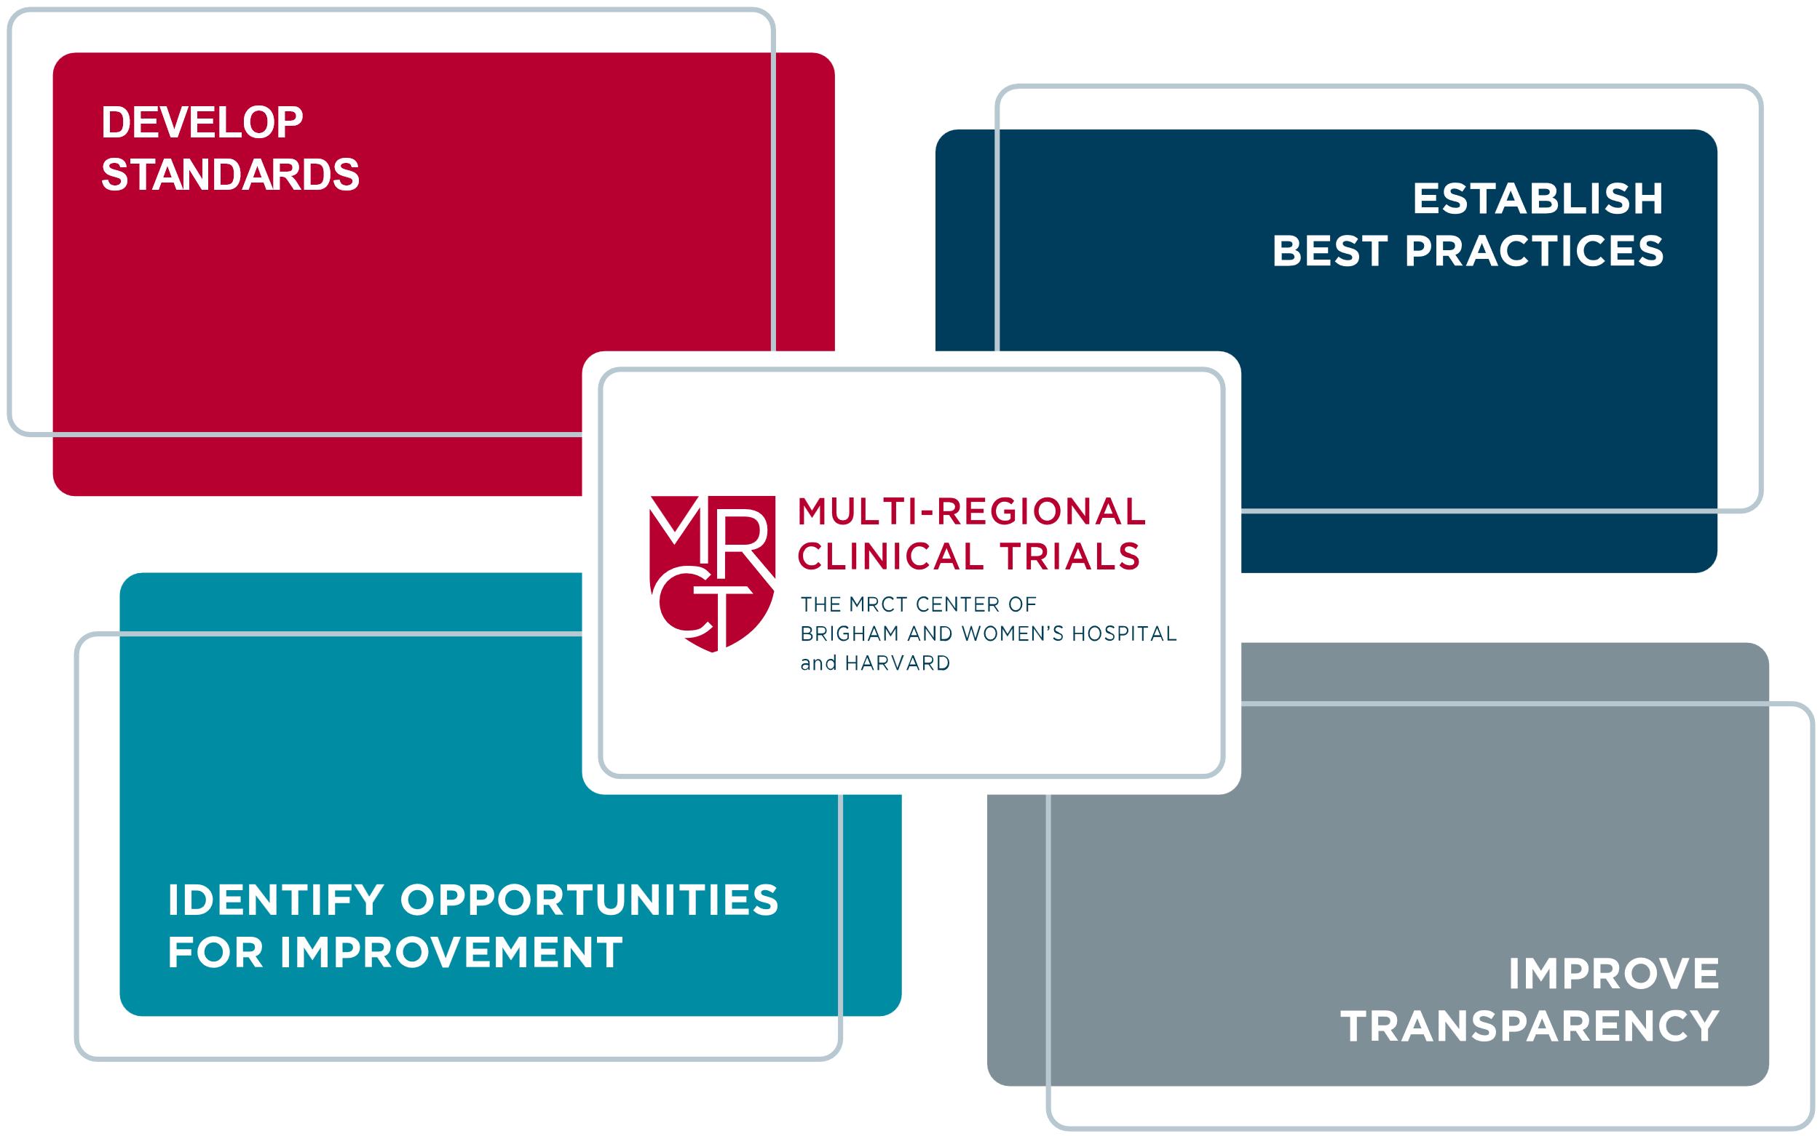
The Multi-Regional Clinical Trials Center (MRCT Center)
The MRCT Center is a research and policy center focused on addressing the conduct, oversight, ethics and regulatory environment for clinical trials.
Our Vision
Improve the integrity, safety, and rigor of global clinical trials.
Our Mission
Engage diverse stakeholders to define emerging issues in global clinical trials and to create and implement ethical, actionable, and practical solutions.

Slide 3
What is Competence?
Knowledge
Skills and Abilities
Attitude
and Behavior
Competence
  Observed
  Measured
  Evaluated

Slide 4
What is Competence?
We must first define the standards and expectations
Before we can assess competency
Knowledge
Skills and Abilities
Attitude
and Behavior
Competence
  Observed
  Measured
  Evaluated

Slide 5
Global Standards for Clinical Research Professionals
The Joint Taskforce for Clinical Trial Competency has identified the knowledge and skills required for safe, ethical and high-quality clinical research.
We are committed to providing researchers worldwide with guidance and tools to ensure the professional competency of all members of the research team.
www.mrctcenter.org/clinical-trial-competency

Slide 6
Timeline of JTF Clinical Trial Competencies
Global survey of
self-assessed competencies and recommendations
Version 2.0 JTF
Website created
Launched JTF Task Force
12 Translations
2013
2018
2019
2014
2015
2016
2017
2021
2020
2022
2023
2024
Version 1.0 JTF Framework
Version 3.0 JTF (Fundamental, Skilled, Advanced)
Spanish Translation
Version 3.1 JTF
(Project Management)
Japanese Translation
Bi-annual global meetings
Patient partners
And data management workgroups

Slide 7
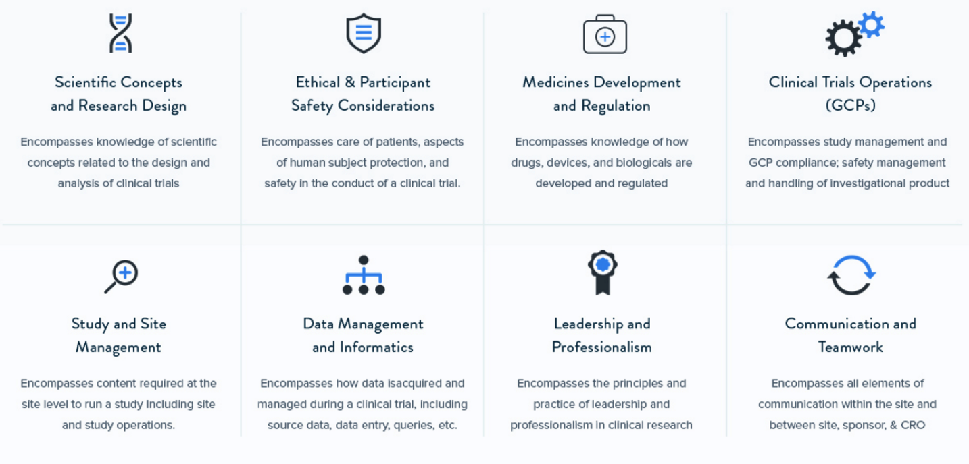
The 8 JTF Competency Domains
Scientific Concepts
and Research Design
Ethical & Participant Safety Considerations
Medicines Development
and Regulation
Clinical Trial Operations (GCPs)
Knowledge of scientific concepts related to the design and analysis of clinical trials
Care of patients, human participant protections, and safety in the conduct of a clinical trial
Knowledge of how drugs, devices, and biologicals are developed and regulated
Study management and GCP compliance; safety management and handling of investigational product
Study and Site Management
Data Management and Informatics
Leadership and Professionalism
Communication and Teamwork
Content required at the site level to run a study including site and study operations
How data are acquired and managed during a clinical trial, including source data, data entry, queries, etc.
The principles and practice of leadership and professionalism in clinical research
All communication within the site and between sites, sponsor, & CRO

Slide 8
Under each domain are specific competency statements
FOR EXAMPLE:
Domain 1: Scientific Concepts and Research Design
Encompasses knowledge of scientific concepts related to the design and analysis of clinical trials
1.1 Apply principles of biomedical science to investigational product discovery and development and health- related behavioral interventions​
1.2 Identify scientific questions that are potentially testable clinical research hypotheses
1.3 Identify the elements and explain the principles and processes of designing a clinical study
1.4 Maintain awareness of new technologies, methodologies, and techniques that enhance the conduct, safety, and validity of the clinical study
1.5 Critically analyze clinical study results

Slide 9
Competencies are reflected at a Basic, Skilled, and Advanced level
1.1 Apply principles of biomedical science to investigational product discovery and development and health-related behavioral interventions
Fundamental Level | Skilled Level | Advanced Level
A1. Recognize the need to apply scientific principles to discovery and development of biomedical investigational products and health-related behavioral interventions | B1. Apply scientific principles when implementing a clinical or behavioral study | C1. Plan biomedical research according to scientific principles
A2. Explain the basic scientific principles that should be applied during development of biomedical investigational products and health-related behavioral interventions | B2. Implement data collection according to scientific principles and based on protocol design | C2. Develop a data management plan according to scientific principles.
Example: When reviewing a clinical research protocol, researcher describes the objective and scientific techniques used to design and implement biomedical research. | Example: When given a clinical research protocol, researcher differentiates what principles could affect how the data should be collected and implement best practices accordingly. | Example: Given a clinical research protocol and data collected, the researcher evaluates the findings to assess results via a scientific framework.

Slide 10
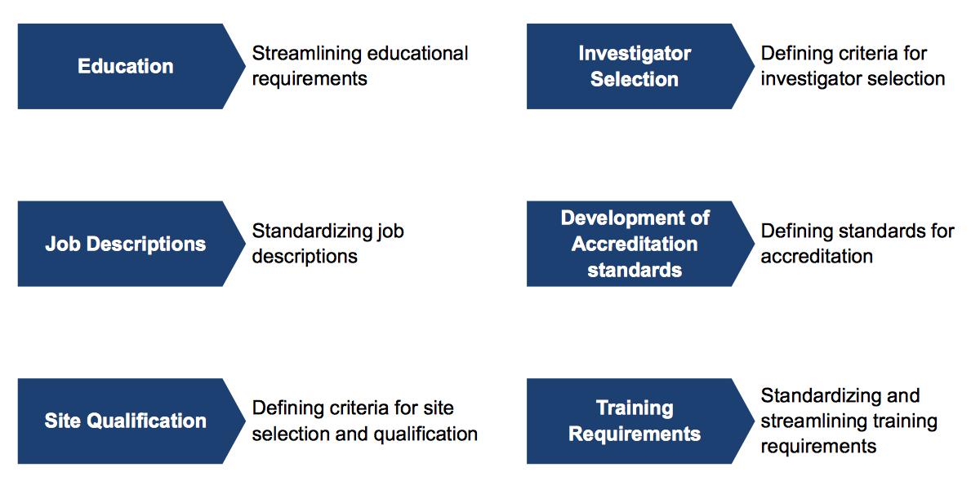
How can the Competency Framework be utilized?
Streamlining educational requirements
Defining criteria for investigator selection
Investigator Selection
Education
Development of Accreditation standards
Defining standards for accreditation
Job Descriptions
Standardizing job descriptions
Site Qualification
Defining criteria for site selection and qualification
Standardizing and streamlining training requirements
Training Requirements

Slide 11


EXAMPLE A:
Duke University: Developing Job Classifications
Built competency-based job classifications for their research professionals
  Refined and incorporated the JFT Core Competencies into existing assessments and training programs
  Developed discrete, tiered-leveled job descriptions
  Assessed employee competencies and encouraged professional development
  Aligned onboarding and training materials
Mapped ~700 current employees into new classifications, reducing job classifications from ~80 to 12
Aligned job descriptions to the current market and updated salaries of existing and incoming employees
Deeter C, Hannah D, Stroo M, et al. Tackling standardization in clinical research workforce hiring using competency-based job classifications. Journal of Clinical and Translational Science. 2023;7(1):e244. https://pubmed.ncbi.nlm.nih.gov/38033703/doi:10.1017/cts.2023.672)

Slide 12
EXAMPLE B:
Standards for the Accreditation of Academic Programs in Clinical Research
The Commission on Accreditation of Allied Health Academic Programs (CAAHEP) in collaboration with the Consortium of Academic Programs in Clinical Research(CoAPCR) have developed a formal accreditation process for academic programs that prepare clinical research professionals that is based on the JTF Core Competency Framework
  Programmatic accreditation in the health professions is a crucial mechanism for ensuring the quality and competency of health professionals.
  In order to achieve accreditation, academic programs must demonstrate learning outcomes in each of the 8 JTF domains
  Accredited degrees enhance career prospects and opportunities for advancement
Sonstein SA, Silva H, Jones CT and Bierer BE (2024) Education and training of clinical research professionals and the evolution of the Joint Task Force for Clinical Trial Competency. Front. Pharmacol. 15:1291675. doi: 10.3389/fphar.2024.1291675

Slide 13
Implementing the Framework was Beneficial
KEY LESSONS FROM 15 CASE STUDIES
Helped build confidence among stakeholders
Was flexible and adaptable
Had broad Application
Facilitated curriculum development
Required leadership for successful implementation
Required roll-out evaluations to validate framework
Streamlined on-boarding training curriculum

Slide 14
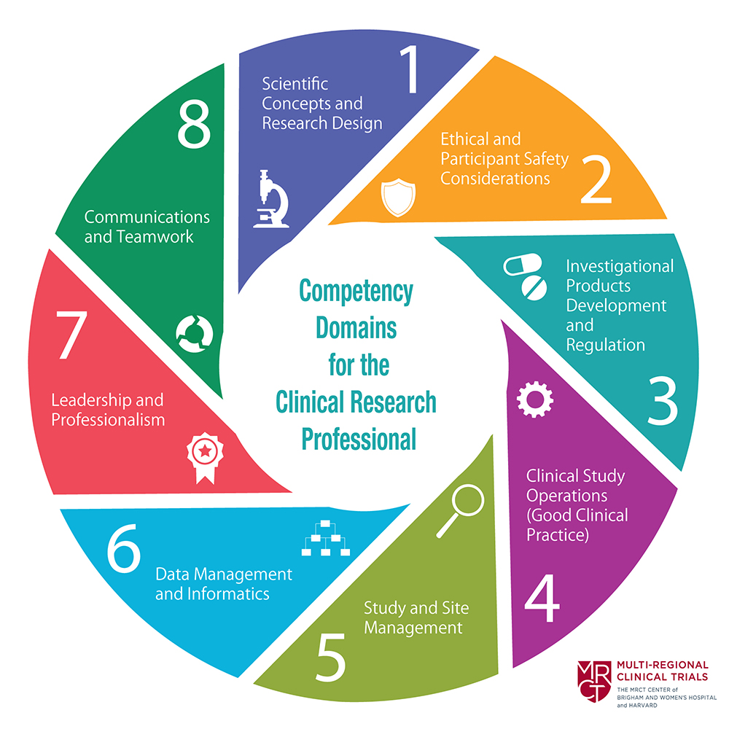

JTF Leveled Core Competency Framework
Download the Framework
of domains, leveled competency statements and examples of how each competency may be implemented in a clinical research environment:
https://mrctcenter.org/clinical-trialcompetency/framework/domains/

Slide 15




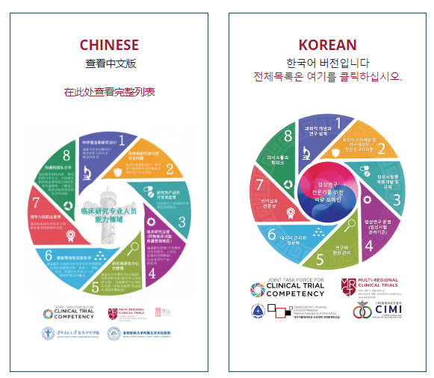

Translations that are currently available:
English
Spanish
Japanese
French
Thai
Bahasa Indonesia
Italian
Vietnamese
Chinese
Korean
Arabic
Portuguese
https://mrctcenter.org/clinical-trial competency/framework/translations/
How to reference the MRCT Center when using the JTF Framework

Slide 16




JTF Continuing Activities
Update the Core Competency Framework based upon regulatory and technological innovation
Expand Core Competency Framework to include patient, participant, and public engagement and partnership
Provide support to individuals and organizations wishing to implement the Core Competency Framework
Expand the adoption and utilization of the Core Competency Framework within the Clinical Research Enterprise

Slide 17


Interested in:
Learning more about the Joint Task Force for Clinical Trial Competency?
Sharing how you have utilized the Framework?
Providing feedback, questions, or ideas?
Participating in our work?
Let Us Know:
https://mrctcenter.org/clinical-trial-competency/about/contact/
To cite the JTF Framework:
How to reference the MRCT Center when using the JTF Framework

